Slide 1
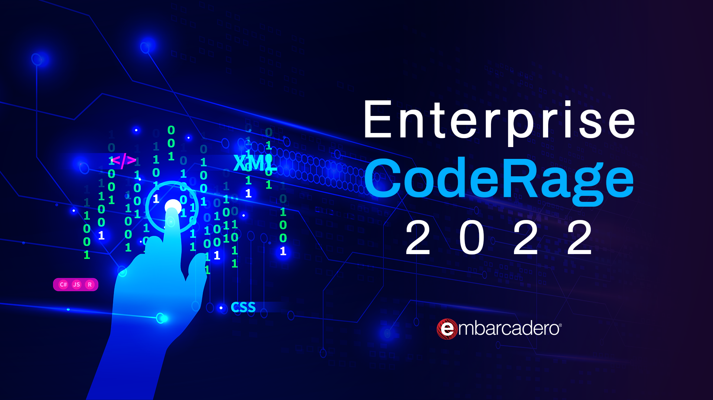

Slide 2



Make MySQL Your SQL
Ian Barker
Embarcadero Delphi MVP
ian.barker@gmail.com
@punctuation
about.me/IanBarker
Slides, link & replay: https://tinyurl.com/makemysqlyoursql

Slide 3

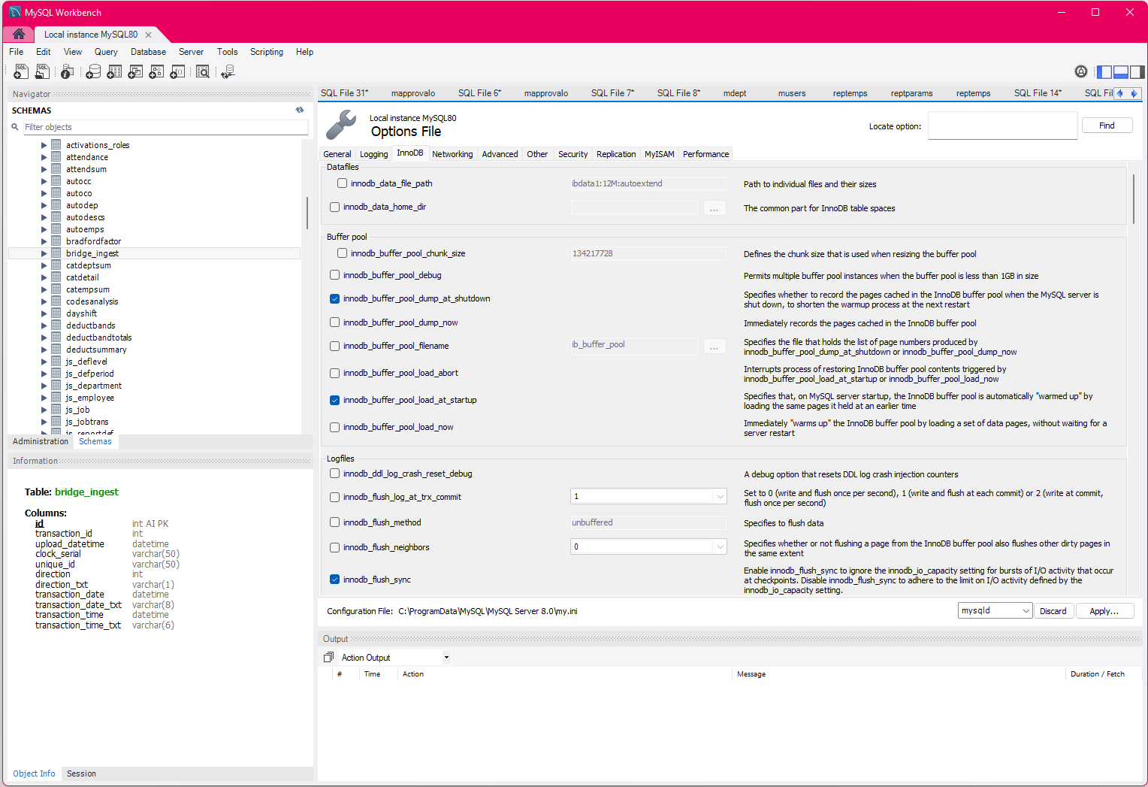
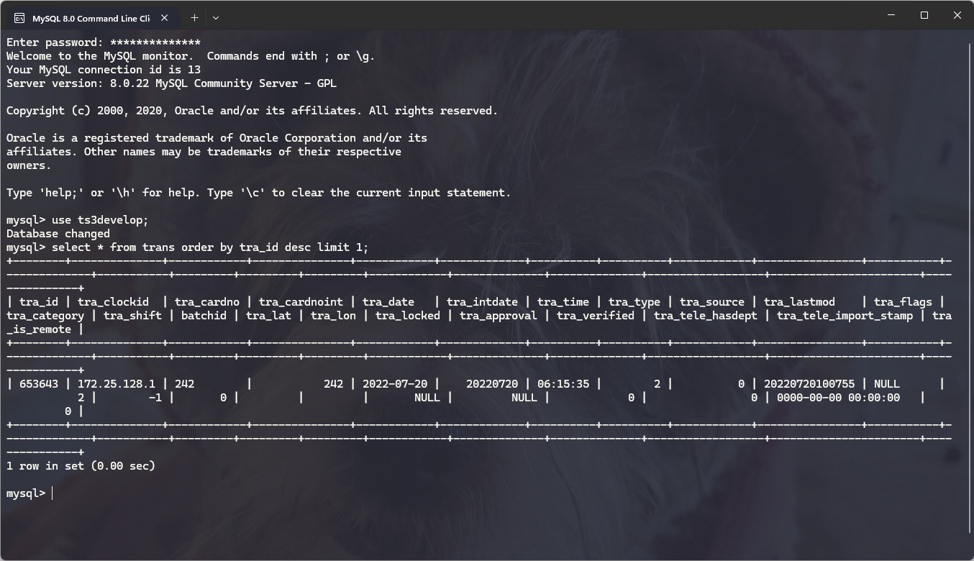
What is MySQL?
MySQL is an enterprise-standard free and open-source client-server relational database management system
It is MASSIVELY popular and can be found powering some of the largest data warehouses in the World
It runs on almost every possible hardware and operating system
Most web hosting companies provide installations or servers running MySQL

Slide 4
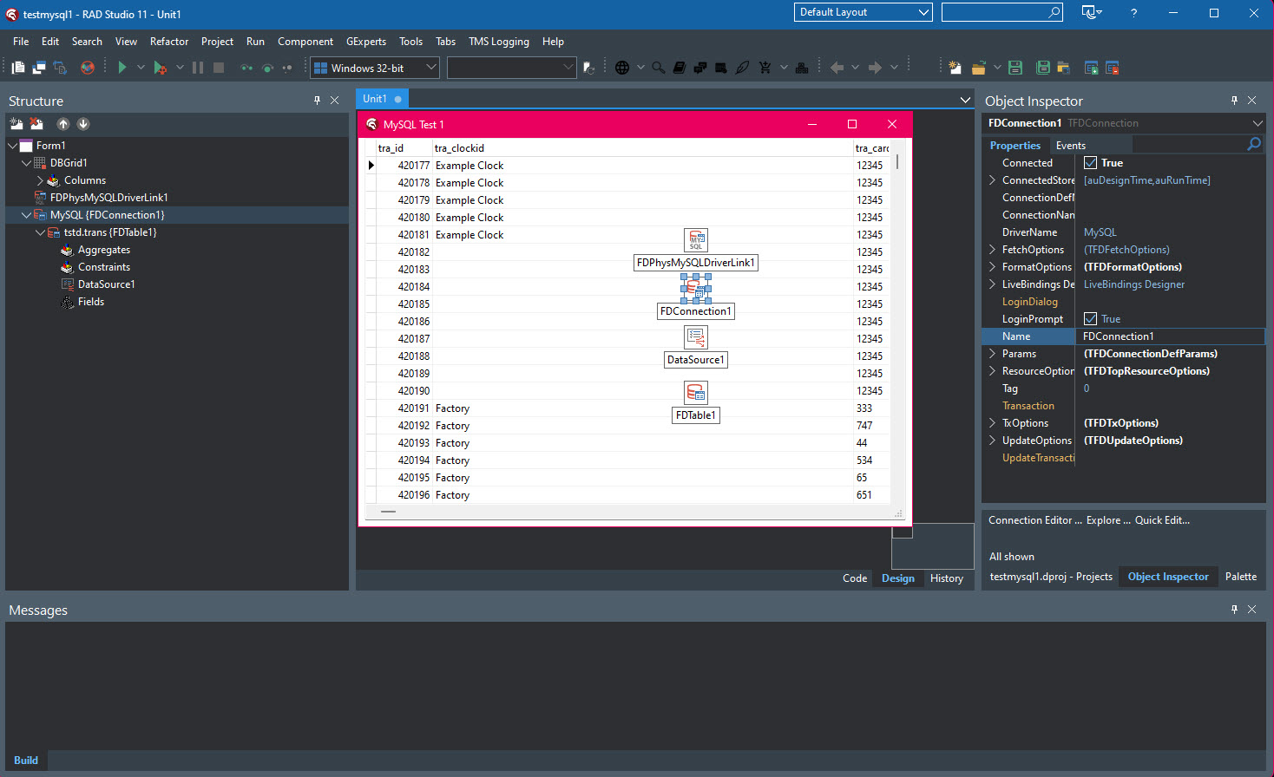
What is MySQL?
But best of all you can easily connect to MySQL using RAD Studio with Delphi or C++ Builder
You can even preview the data live at design time in the IDE!

Slide 5


Make MySQL Your SQL – some facts
MySQL has been around for 27 years
It is the “M” in LAMP web stacks
Originally created by Michael Widenius at MySQL AB
It’s called MySQL because Michael’s eldest daughter is called My
Was bought by Sun Microsystems and then Oracle the present owners
Notes:
Linux, Apache, MySQL and PHP

Slide 6

Make MySQL Your SQL – some facts
There are two main types of MySQL
Commercial (paid)
Community Server (free and open-source)
Widenius went on to create MariaDB which is a fork of MySQL
MariaDB is largely compatible with MySQL
…and “Maria” is his other younger daughter, hence the name MariaDB 😁
And yes, he does have another child – Max. He named MaxDB after him!

Slide 7
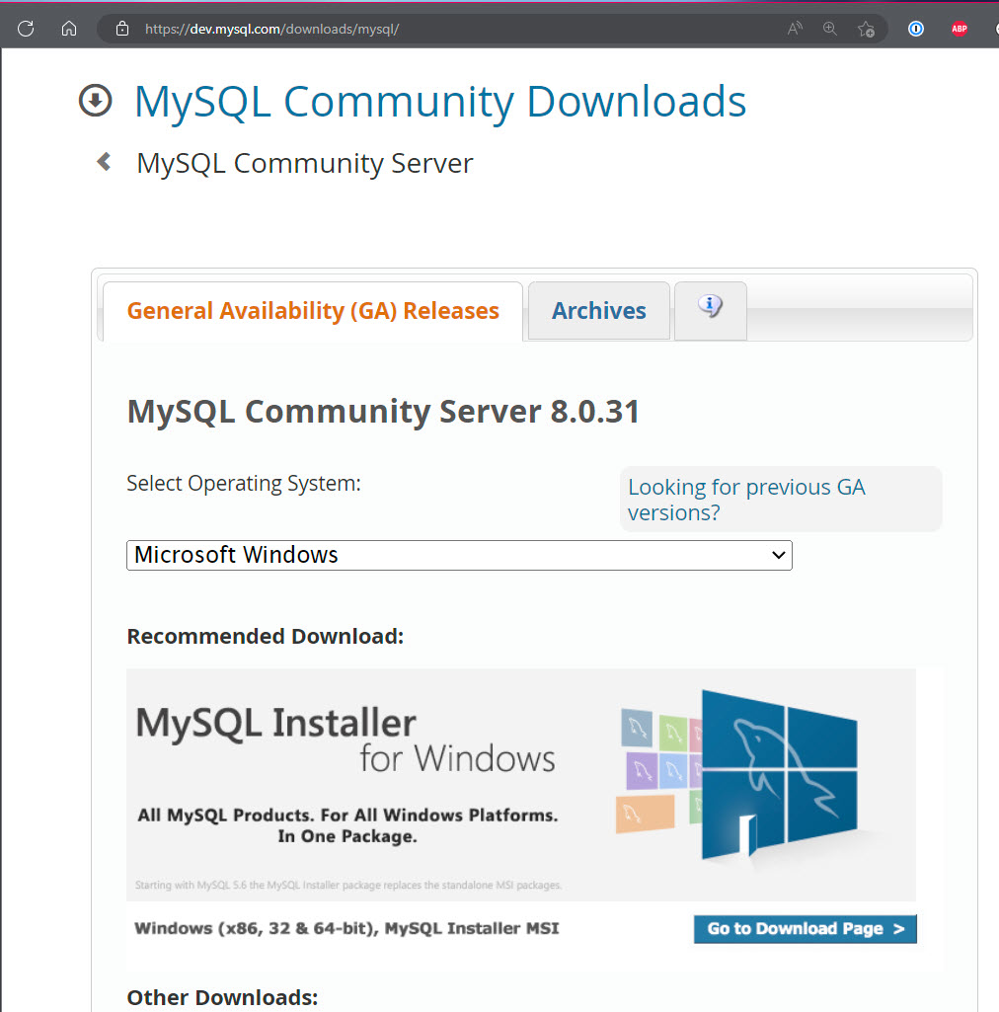
Getting MySQL
Download the community version from
https://dev.mysql.com/downloads/mysql/
You can also download ready-installed virtual machines from most providers

Slide 8

Getting MySQL
Let’s install MySQL and MySQL Workbench…
Notes:
install_mysql.mp4

Slide 9
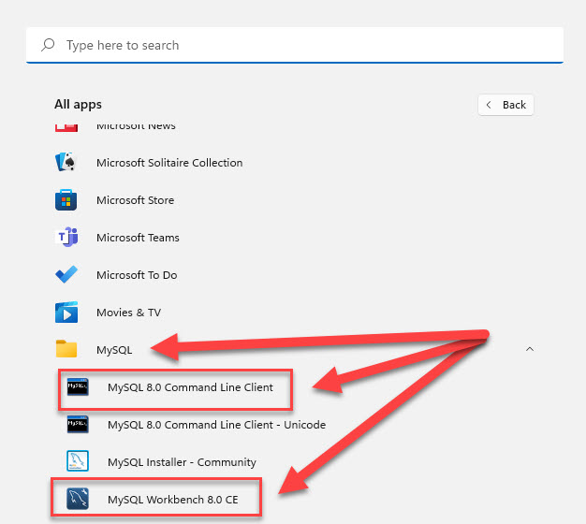
Tools to work with MySQL databases
On the server you will find a MySQL folder
Contains the MySQL Command line
MySQL Workbench (if you installed it)

Slide 10
Tools to work with MySQL databases
On the server you will find a MySQL folder
Contains the MySQL Command line
MySQL Workbench (if you installed it)
Notes:
mysqlcxommandline.mp4

Slide 11
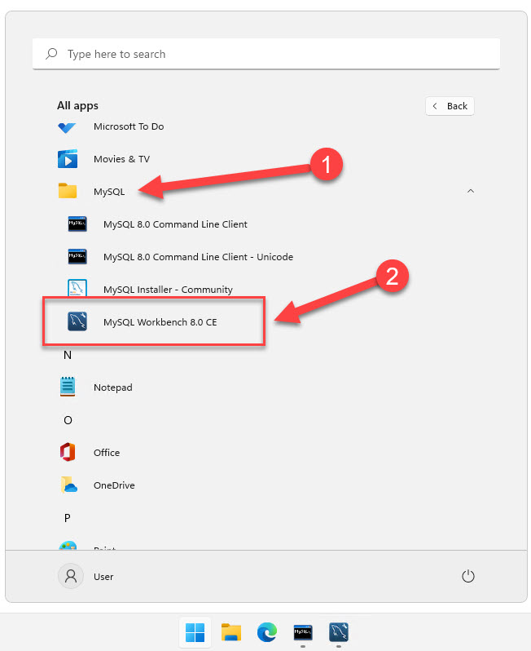
Tools to work with MySQL databases
On the server you will find a MySQL folder
Contains the MySQL Command line
MySQL Workbench (if you installed it)

Slide 12
Tools to work with MySQL databases
On the server you will find a MySQL folder
Contains the MySQL Command line
MySQL Workbench (if you installed it)

Slide 13
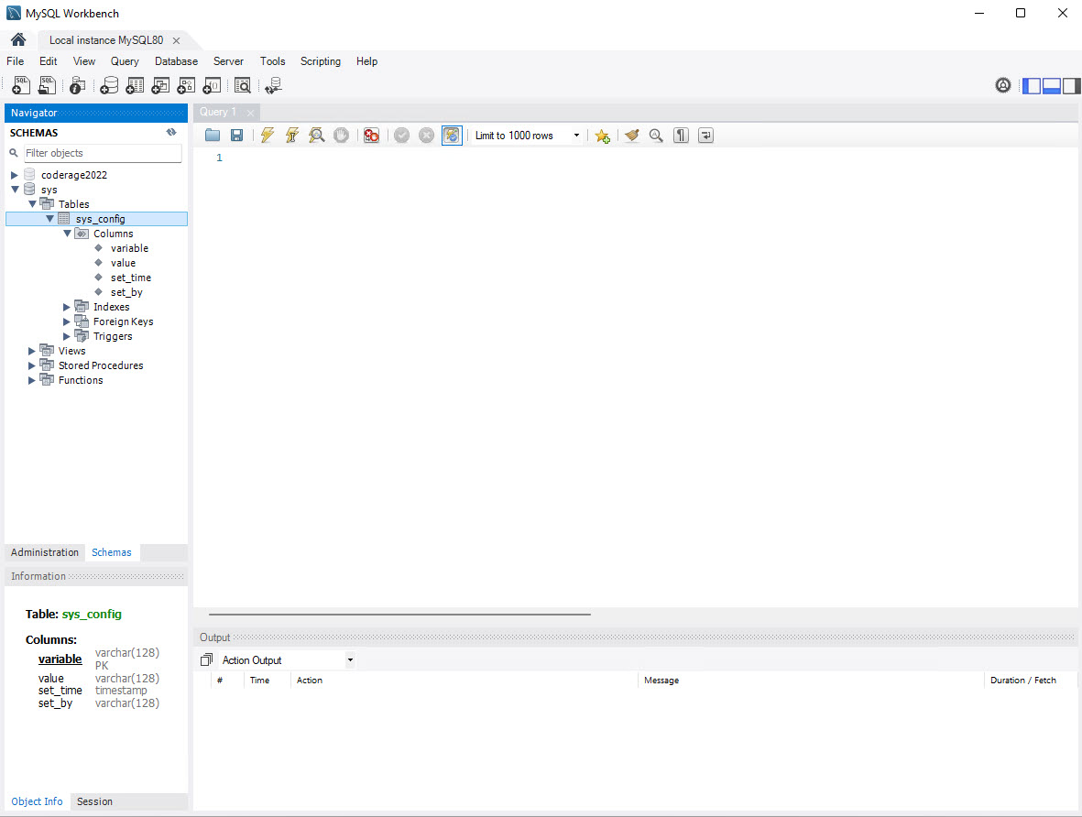
MySQL Workbench
A lot easier to use than the command line
Can work with multiple MySQL databases on multiple servers at the same time
MySQL Command line is quicker for some things such as executing large SQL scripts

Slide 14
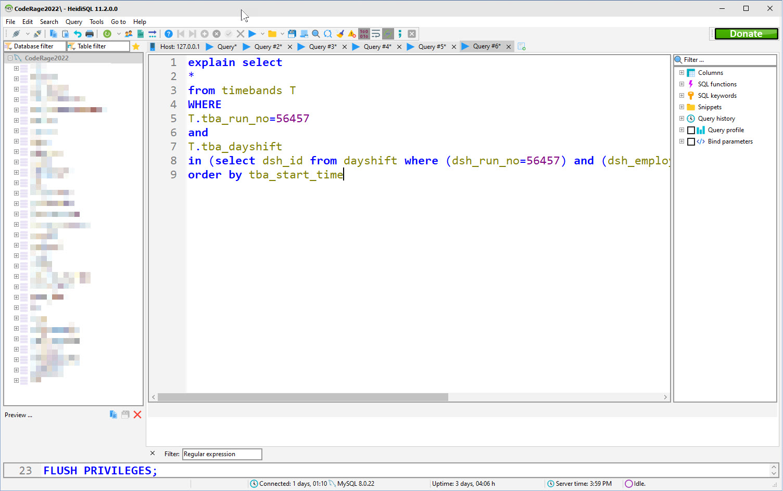

HeidiSQL
Free and open source
Written in Delphi
Extremely powerful and very popular competitor to MySQL Workbench
Get it from https://www.heidisql.com

Slide 15
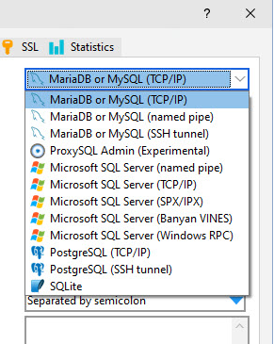
HeidiSQL
Can connect to all versions of MySQL and MariaDB
Can also do MS SQL Server, PostgreSQL, and SQLite
Has 32bit and 64bit versions
Also a ‘portable’ version which can run from a memory stick / thumbdrive
Full Delphi source code https://github.com/HeidiSQL/HeidiSQL

Slide 16
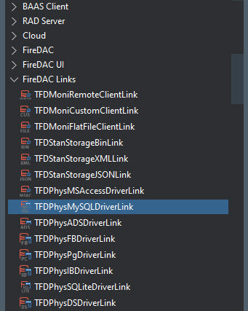
Connecting to MySQL with Delphi / C++ Builder
FireDAC
Comes included with Delphi and C++ Builder
Very powerful native Delphi DB components
Requires a driver DLL to connect*
https://docwiki.embarcadero.com/RADStudio/Sydney/en/Connect_to_MySQL_Server_(FireDAC)
*more on that in a minute

Slide 17

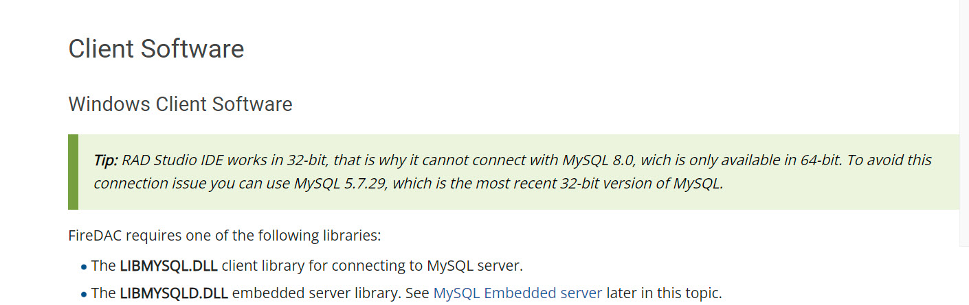
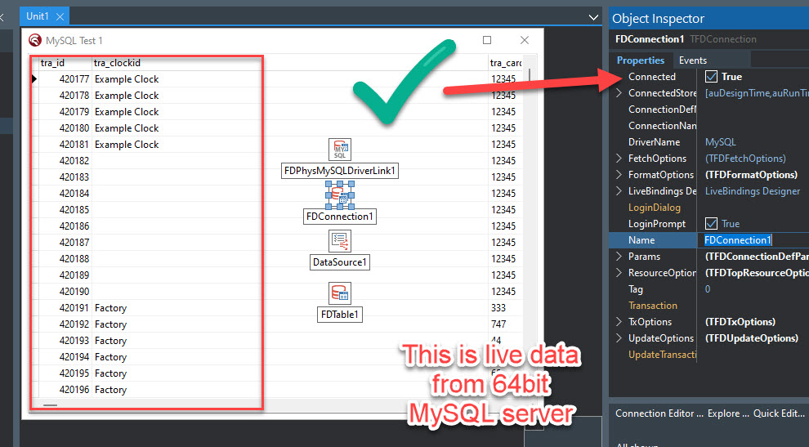
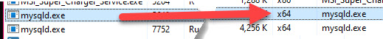
Connecting to MySQL using FireDAC
https://docwiki.embarcadero.com/RADStudio/Sydney/en/Connect_to_MySQL_Server_(FireDAC)
The official documentation is wrong 🤪
You can definitely get RAD Studio to connect live to a 64bit MySQL server!

Slide 18
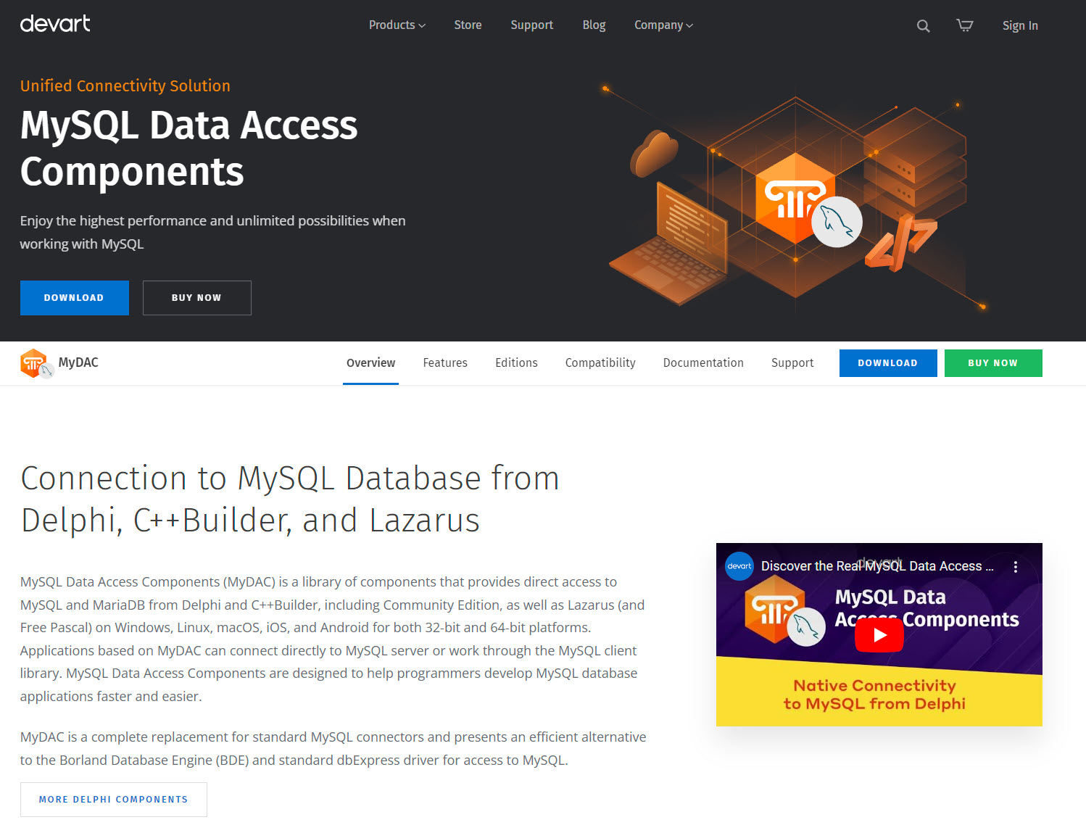
Connecting to MySQL with Delphi / C++ Builder
Devart UniDAC and MyDAC
Commercial (paid) database connection components
Similar to FireDAC
Has a “direct mode” which means using the external driver DLL is optional
https://www.devart.com/mydac/

Slide 19
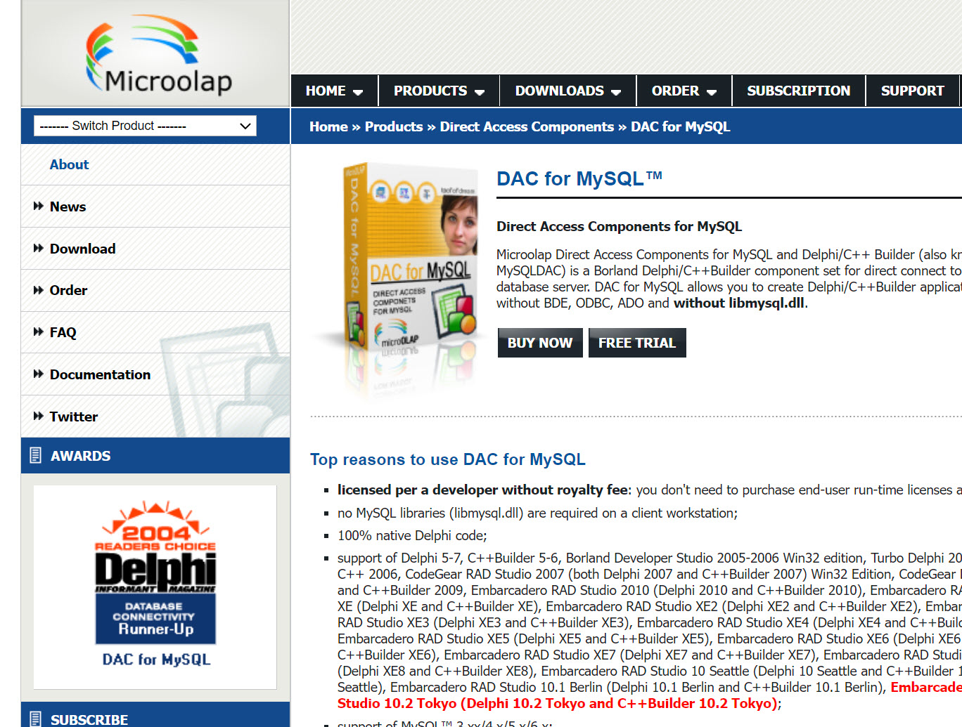
Connecting to MySQL with Delphi / C++ Builder
Microolap DAC for MySQL
Commercial (paid) database connection components
Similar to TDatabase, TTable, TQuery
Is fully “direct mode” so external driver DLL is not required
http://www.microolap.com/products/connectivity/mysqldac/

Slide 20
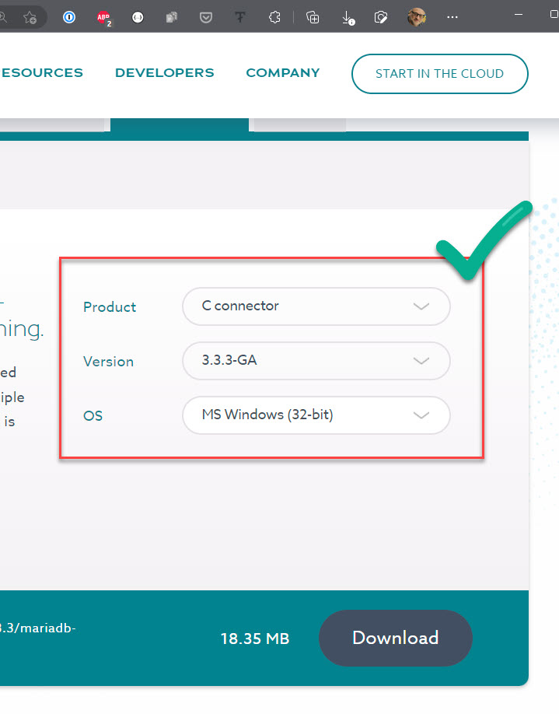
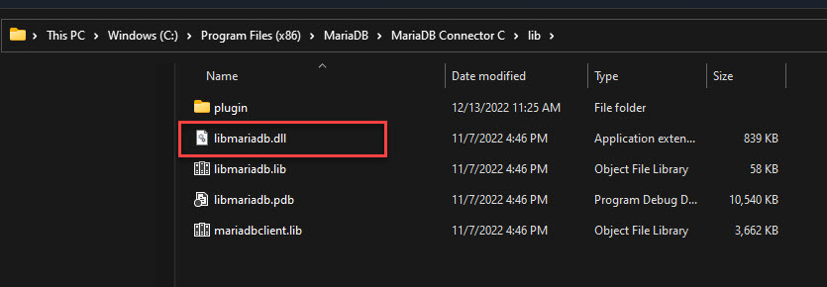
How to get the libmariadb or libmysql driver dlls
Option 1: Download the MariaDB C connector
This installs the libmariadb.dll onto your machine in the %ProgramFiles(x86)% folder
https://mariadb.com/downloads/connectors/

Slide 21
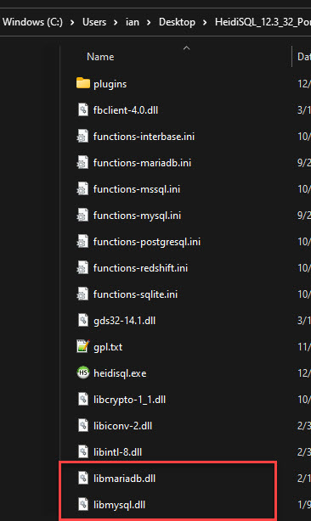
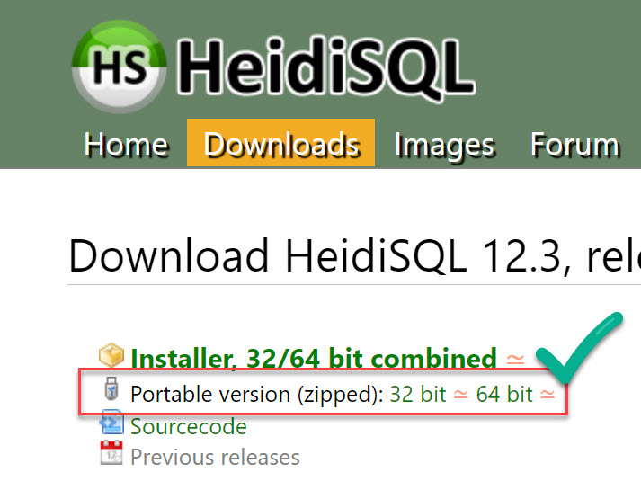
How to get the libmariadb or libmysql driver dlls
Option 2: Download the portable version of HeidiSQL
This downloads a zip file with either the 32 or 64 bit version of the libraries
Unzip it into its own folder
The required DLLs are in the root of that folder
https://www.heidisql.com/download.php

Slide 22
The libmariadb or libmysql driver dlls
Note that the driver DLLs are only required for FireDAC and to have RAD Studio / C++ Builder preview the data live
They MUST be the 32bit versions for RAD Studio / C++ Builder or it will not work and will display an error
The 32bit driver DLLs can connect to the 64bit versions of MySQL and MariaDB server (the documentation is incorrect)

Slide 23
Connecting to MySQL - FireDAC
Let’s connect to a MySQL server LIVE in the RAD Studio IDE using FireDAC…
Notes:
firedac_mysql_all.mp4

Slide 24
Connecting to MySQL – MicroOlap DAC for MySQL
Let’s connect to a MySQL server using the Microolap DAC for MySQL components…
Notes:
mysqldac_livetscproj.mp4

Slide 25
Connecting to MySQL – MicroOlap DAC for MySQL
Let’s connect to a MySQL server using MyDAC components from Devart…
Notes:
mysqldac_livetscproj.mp4

Slide 26
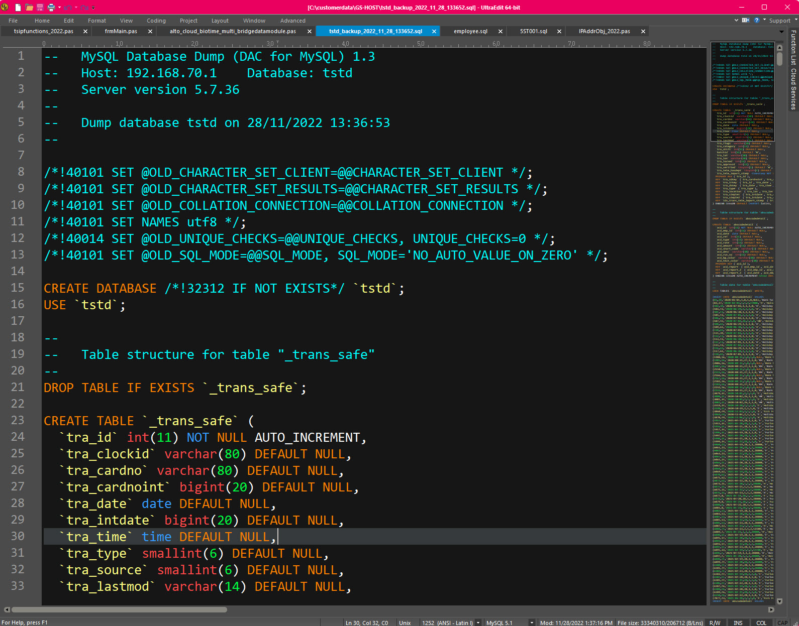
Other tips
SQL scripts can get very large
UltraEdit can handle HUGE files very quickly
https://www.ultraedit.com

Slide 27


Thanks for watching…
Make MySQL Your SQL
Ian Barker
Embarcadero Delphi MVP
ian.barker@gmail.com
@punctuation
about.me/IanBarker
Slides, link & replay: https://tinyurl.com/makemysqlyoursql

